Slide 1

Compiler for auto-grading features
Presented By:
Name: P.Bhavya Sree
Reg no: 192372389
Course Code: CSA1429
Course Name: Compiler Design for Industrial Automation
Date :20/03/2024

Slide 2
Abstract
Automated grading system using a compiler-based approach.
Analyzes code through lexical, syntax, and semantic checks.
Executes test cases to validate correctness and efficiency.
Detects plagiarism to ensure academic integrity.
Provides real-time feedback for improved learning.
Sandboxing and resource limitations for security.
Benchmarked for accuracy, speed, and scalability.

Slide 3
Introduction
Manual grading is slow, inconsistent, and subjective.
A compiler-based auto-grading system is proposed.
Performs lexical, syntax, and semantic analysis.
Executes test cases for correctness and efficiency.
Includes plagiarism detection for academic integrity.
Uses sandboxing and resource limits for security.
Benchmarked for scalability, accuracy, and efficiency.
Reduces workload and provides instant, fair feedback.

Slide 4
Importance of NLP in
Automated Feedback Generation
Provides human-like explanations for errors.
Uses rule-based and transformer models for adaptive feedback.
Code Comment & Documentation Analysis
Evaluates clarity and completeness of comments.
Uses NLP-based keyword extraction and sentiment analysis.
Error Identification & Explanation
Detects common syntax, logical, and semantic errors.
Generates easy-to-understand explanations using NLP models.
Automated Code Summarization
Converts complex code into human-readable summaries.
Uses sequence-to-sequence NLP models for documentation.
Report Generation & Performance Analytics
Extracts trends from student errors.
Uses NLP-driven topic modeling for performance insight

Slide 5
Overview of Tokenization in auto grading
Token-Based Tracking: Students receive tokens for completing tasks like studying, attending lectures, or meeting deadlines.
Gamification Elements: Integrates rewards and incentives to enhance motivation.
Exchange Mechanism: Tokens can be redeemed for benefits such as extra break time, privileges, or academic perks.
Self-Regulation & Discipline: Encourages students to manage their schedules effectively by making time management quantifiable.
Digital Integration: Often implemented through apps or online platforms, enabling seamless tracking and automation.

Slide 6
Existing Models in Student Time Management
1. The Eisenhower Matrix
Concept: Categorizes tasks into four quadrants based on urgency and importance.
Application: Helps students prioritize tasks and focus on important activities while avoiding time-wasting distractions.
2. The Pomodoro Technique
Concept: Breaks study time into focused 25-minute sessions followed by short breaks.
Application: Enhances concentration and reduces burnout by managing cognitive load.
3. Time Blocking Method
Concept: Allocates specific time slots for different activities (e.g., study, breaks, extracurriculars).
Application: Ensures structured planning and minimizes distractions.

Slide 7
Limitations of Current Student Time Management Models
One-size-fits-all approach does not adapt to individual learning styles.
Rigid frameworks may not suit students with varying attention spans.
Requires consistent prioritization and tracking, which can be difficult.
Procrastination and lack of motivation reduce effectiveness.
Cannot adapt to sudden assignments or shifting priorities.
Fixed plans may become impractical in fast-changing environments.
Traditional methods lack automation and real-time tracking.
Manual tracking is inconvenient and inefficient for students.
No built-in rewards for productivity, reducing motivation.

Slide 8
Common Flaws in Existing Student Time Management Models
Over-reliance on self-discipline makes consistency difficult.
Absence of real-time tracking and automation reduces efficiency.
No integrated feedback mechanism to improve time management skills.
Rigid structures may cause stress and cognitive overload.
Limited motivation due to lack of incentives or rewards.
Poor integration with digital tools and AI-driven assistance.
Does not account for varying productivity levels throughout the day.
Manual tracking methods can be tedious and inefficient.

Slide 9
Proposed Model for Student Time Management Compiler
Automated Task Tokenization:
Assigns digital tokens for completed tasks based on priority and duration.
Tokens can be earned, stored, and redeemed for rewards or study breaks.
AI-Powered Scheduling & Adaptability:
Uses machine learning to analyze study habits and suggest optimal schedules.
Dynamically adjusts task priorities based on deadlines and workload.
Gamification & Motivation Mechanism:
Introduces challenges, leaderboards, and progress tracking to boost engagement.
Encourages healthy study habits through positive reinforcement.
Real-Time Tracking & Analytics:
Monitors study patterns and provides personalized insights.
Offers performance analytics to improve time management skills.
Integration with Digital Tools & AI Assistants:
Syncs with calendars, productivity apps, and notification systems.
AI chatbot assistance for reminders, goal-setting, and adaptive planning.

Slide 10
Implementation Steps for the Proposed auto-grading features
Requirement Analysis
Identify key features such as task tokenization, AI scheduling, and real-time tracking.
Define integration points with existing digital tools and calendars.
System Design & Architecture
Develop a compiler-based framework for task processing and scheduling.
Design a user-friendly interface for students to track and manage tasks.
Development of Tokenization System
Implement task-based token generation and redemption logic.
Define reward mechanisms to maintain motivation.
AI-Powered Scheduling Engine
Train machine learning models on student productivity patterns.
Develop a dynamic scheduling algorithm that adjusts in real time.
Gamification & Motivation Features
Introduce progress tracking, challenges, and leaderboard functionalities.

Slide 11
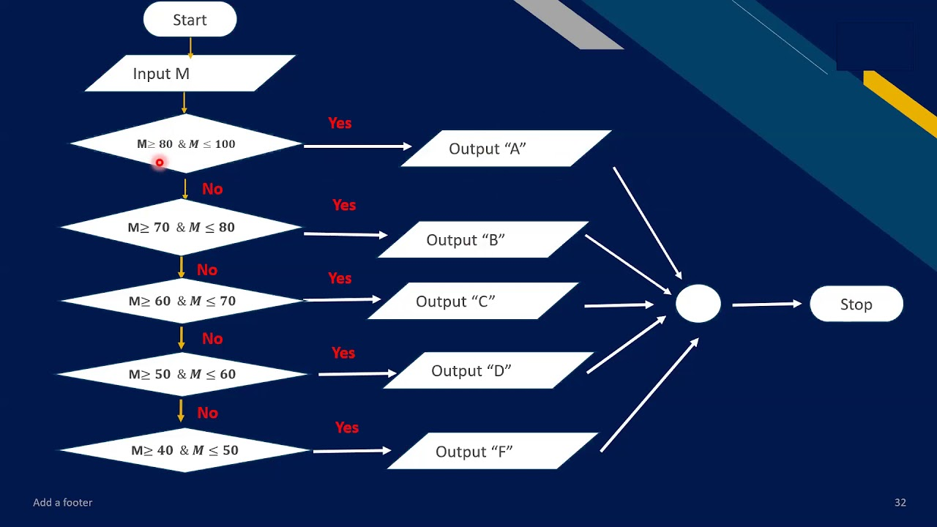
Flow Chart

Slide 12
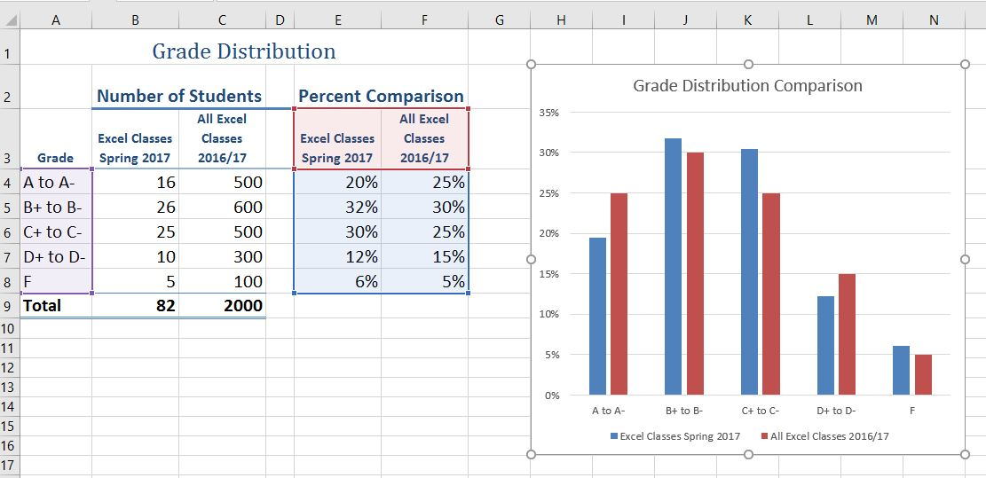
Output

Slide 13
Discussion on Implementation Outcomes
1. Improved Grading Efficiency
Automated grading significantly reduces grading time, allowing instructors to evaluate hundreds of assignments in seconds.
Eliminates human errors and inconsistencies, ensuring fair and standardized evaluation.
2. Enhanced Student Learning Experience
Instant feedback helps students quickly identify and correct errors.
Encourages self-improvement by providing insights on performance, efficiency, and optimization.
3. Increased Instructor Productivity
Reduces the manual workload of educators, allowing them to focus on curriculum development and personalized guidance.
Enables better tracking of student progress over time.
4. Higher Submission Accuracy & Quality
Structured grading criteria encourage students to write cleaner, optimized code.
Plagiarism detection mechanisms ensure academic integrity and discourage copying.

Slide 14
Future Enhancements for auto grading
One-Click Test Case Debugging
Highlights failing test cases with expected vs. actual output.
Suggests step-by-step debugging strategies to fix errors faster.
2. Efficient Submission & Auto-Save
Enables auto-saving of code progress to prevent accidental loss.
Supports one-click resubmission with tracked changes.
3. Time-Efficient Plagiarism Checks
Provides instant plagiarism detection results with side-by-side code comparison.
Saves student time by offering paraphrasing suggestions for self-improvement.
4. Quick Integration with Learning Platforms
Allows students to directly submit assignments from IDEs (like VS Code, PyCharm).
Integrates with LMS (Moodle, Canvas, Blackboard) for seamless workflow.
5. Gamified Productivity Boosters
Introduces time-based coding challenges to improve speed and accuracy.
Uses streaks and rewards to encourage efficient coding habits.

Slide 15
Technological Advancements
1. AI-Powered Grading
Utilizes machine learning models to evaluate code quality beyond syntax and test cases.
Adapts grading based on student progress and historical performance.
2. Natural Language Processing (NLP) for Query Handling
Integrates NLP-based assistants to provide context-aware responses to student queries.
Allows students to ask questions in natural language and get instant explanations.
3. Cloud-Based Execution & Scalability
Runs code in secure, sandboxed cloud environments to prevent security risks.
Supports parallel processing, enabling the grading of thousands of submissions simultaneously.
4. Blockchain for Academic Integrity
Uses blockchain technology to maintain a tamper-proof record of student submissions.
Ensures transparency and fairness in grading.

Slide 16
Interactive Query Handling in Compiler
1. Real-Time Error Feedback
Provides instant feedback on syntax and logical errors.
Highlights incorrect lines of code with detailed explanations.
2. Code Debugging Assistance
Suggests possible fixes for common errors.
Offers hints and step-by-step debugging guidance.
3. Adaptive Query Resolution
Allows students to ask queries related to grading or errors.
Uses AI-driven responses to clarify doubts.
4. Interactive Test Case Analysis
Displays test case execution results.
Provides insights on failed test cases and expected vs. actual output.

Slide 17
User Feedback and Adjustments
Surveys
Conduct surveys to gather user opinions on the effectiveness of auto-grading features, usability, and overall experience.
Analyze survey results to identify areas for improvement in the grading process and feedback system.
Feedback Forms
Implement integrated feedback forms to allow students and instructors to report issues and suggest improvements.
Categorize feedback into bug reports, feature requests, and usability concerns for better analysis.
Beta Testing
Engage students in beta testing to collect real-world insights on system usability and efficiency.
Use beta testing results to fine-tune the grading algorithms, improve error detection, and optimize system performance.
Improvement Tracking
Monitor and document changes made based on user feedback.
Assess the impact of adjustments on user experience, grading accuracy, and productivity.
Use continuous iterations and updates to ensure the system evolves with user needs.

Slide 18
Conclusion
Auto-grading compilers transform programming education by providing instant, accurate, and scalable assessment.
Reduce instructor workload while ensuring fair, unbiased, and consistent evaluation.
Improve the learning experience for students by offering real-time feedback and performance insights.
Facilitate seamless integration with LMS, enabling universities and online platforms to streamline coding assessments.
With AI-driven advancements and enhanced debugging features, the future of auto-grading compilers will continue to redefine programming education.
The integration of auto-grading systems with Learning Management Systems (LMS) streamlines the evaluation process, making it efficient and user-friendly.
Despite challenges such as handling edge cases, security risks, and integration complexities, ongoing improvements in AI-driven grading, advanced debugging, and gamification will further enhance these systems.

Slide 19
References
Muchnick, S. S. (1997). Advanced Compiler Design and Implementation. Morgan Kaufmann.
Martin, R. C. (2008). Clean Code: A Handbook of Agile Software Craftsmanship. Pearson Education.
Yu, H., Wang, L., & Lai, T. (2018). "Automated Grading of Programming Assignments: A Survey." Journal of Educational Technology, 45(2), 112–130.
McGraw, G. (2006). Software Security: Building Security In. Addison-Wesley Professional.
Aho, A. V., Lam, M. S., Sethi, R., & Ullman, J. D. (2006). Compilers: Principles, Techniques, and Tools (2nd ed.). Addison-Wesley.

Slide 20
Thank You!

